Slide 1
Opening Briefing

Slide 2






























It is a pleasure and an honour to be here with you today. We are looking forward to working with you and your team over the coming days.
今天我很高興和榮幸來到這裡，我期待著在未來的几天里與您和您的團隊一起工作。
Notes:
Introduction. Also an opportunity to talk a bit about Demix
Demix has LAs from across the globe and performs appraisals around the world
Demix is one of the largest CMMI services providers globally
Demix also provide other citification services, such as ISO, COBIT, MAX
It is a pleasure and honour to be here with you today. We are looking forward to work with you and your team over the coming days.
早晨好。今天我很高興和榮幸來到這裡，我期待著在未來的几天里與您和您的團隊一起工作。

Slide 3

DEMIXIUM™
Demixium™ Copyright Demix 2021-2024
Demixium is a collection of best practices to assess an organisation across a variety of domains and best practice models. It is available for free use under the MIT free use license agreement.
Demixium 是一组最佳实践的集合，用于跨各种领域和最佳实践模型评估组织。 它可根据 MIT 免费使用许可协议免费使用。
www.demixium.com
Knowledge | Performance | Results

Slide 4
Appraisal Overview 评估概述
Notes:
Information in this section should come from the appraisal plan. The idea here is not to duplicate the contents of the plan, but to provide a summary for the Appraisal Sponsor, and the personnel from the OU who will see these findings.
The ATL may add additional information to the final findings presentation, but this minimum content must be present.

Slide 5
Appraisal Overview
Notes:
This is information that must be recorded in the appraisal plan.

Slide 6
Appraisal Overview
Notes:
This is information that must be recorded in the appraisal plan.

Slide 7
Business and Appraisal Objectives

Slide 8
Appraisal Principles
Start with a process framework 以一个过程框架作为开始
Observe strict confidentiality and non-attribution 严格遵循保密性和不归因性
Involve senior management as appraisal sponsor 把高层作为评估发起人
Approach appraisal collaboratively to the extent possible 评估需要协调合作进行
Focus on action 关注行动
Notes:
1, what ever you share is confidential with the ATM’s and
2, non – your name will not appear in any reports
collaboratively – we have representation from your side as well as ours last at the end there are always weaknesses and from there an improvement action is always undertaken

Slide 9
Virtual appraisals – code of conduct
A virtual appraisal code of conduct must include the following rules at a minimum: (ISACA MDD v2.2)
远程评估行为准则必须包括以下规则：(ISACA MDD v2.2)
Participate actively in appraisal activities 积极参与评估活动。
No sleeping, multitasking, etc. 不允许睡觉，或进行其他工作等。
To meet confidentiality requirements, ATL may require no additional media or writing materials, laptops, or mobile devices other than those agreed as necessary for conducting virtual activities for some or all interviews 为了满足保密需求，除了评估所需的设备和材料外，主任评估师可能不需要其他设备或材料：包括纸质材料，其他笔记本电脑，移动设备等。
One person speaks at a time 每次只允许一个人说话。
All participants identify themselves when needed, including when asked by ATL, to verify their identity with a government issued photo ID. 评估师要求时，所有访谈人员需要出示身份证验证身份，身份证由政府发放且附带个人照片。
Additional required actions 其他行为准则：
Video cameras should be on at all time. 摄像机需要一直保持开启状态。

Slide 10
Appraisal Team and Support Personnel
Notes:
Take basic information from the appraisal plan.

Slide 11
Appraisal Scope – Benchmark Model View
Notes:
Make sure the version of the model is correct when this slide is built. Replace the bold, italicized x with the correct version number.

Slide 12
Appraisal Scope – Organizational Scope

Slide 13
Appraisal Scope – Organizational Sample
Notes:
The ATL can show the chart from the generated random sample, but there must be a description of the sampled projects and their selected CA/PA grouping.

Slide 14
Appraisal Scope – Organizational Sample

Slide 15
Appraisal Scope – Organizational Sample

Slide 16
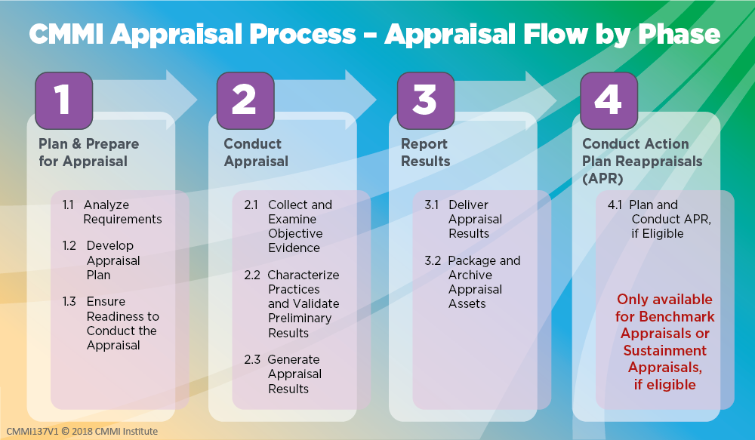

Slide 17
Ratings for
EXAMPLE
Notes:
For each practice, enter the OU-Level characterization (FM, LM, PM, DM, NY). The chart will set a color.
Based on the characterizations of all practices in each practice level, set the Practice Level rating to “S” (Satisfied) or “U” (Unsatisfied).
The PA Rating is the Highest Practice Level at which all practices for it, and all lower Practice Levels, are Satisfied.
For details, see the MDD, Activity 2.3.2 Determine Practice Group Ratings, and Activity 2.3.3 Determine Practice Area and Maturity Level or Capability Level Profile Rating.

Slide 18
Findings Definitions – Required Categories
Required Findings Categories:
Weaknesses - A type of preliminary or final finding, which is an ineffective, or lack of implementation of one or more processes that meet the intent and value of a practice based on verified objective evidence, and applicable across the project(s) and organizational support functions or Organizational Unit as a whole. This is realized either by a) the process itself does not address a CMMI practice requirement, or b) the project(s) or organizational support functions are not following their process that IS compliant with the intent and value of the applicable CMMI practice.
Strengths - A type of preliminary or final finding, which is an exemplary or noteworthy implementation of a process that meets the intent and value of a CMMI model practice.
所需结果类别：
弱项——一种初步或最终的发现，是指一个或多个过程实施无效或缺乏实施，这些过程基于已验证的客观证据，符合实践的意图和价值，适用于整个项目和组织支持职能组或组织单元。这可以通过以下两种方式实现：a）过程本身没有满足CMMI实践需求，或者b）项目或组织支持职能组没有遵循符合适用CMMI实践意图和价值的过程。
强项——一种初步或最终的发现，是一个模范性或值得注意的过程实现，其符合CMMI模型实践的意图和价值。

Slide 19
Appraisal Outputs

Slide 20
Appraisal Schedule

Slide 21


Slide 22
Notice
This pptx has embedded links to 00_Data_Reference.xlsm
The latest information and version of the Benchmark Appraiser Support Environment (BASE) can be accessed at www.demix.org/tools

